Slide 1
Lecture 9 Bayesian Networks
291K Machine Learning
Lei Li and Yu-xiang Wang
UCSB
Some slides adapted from Yexiang Xue, Pat Virtue

Slide 2
Recap
Attention mechanism in neural networks
Transformer
Multi-head attention
Positional embedding
Residual connection
Layer norm
Cross attention

Slide 3

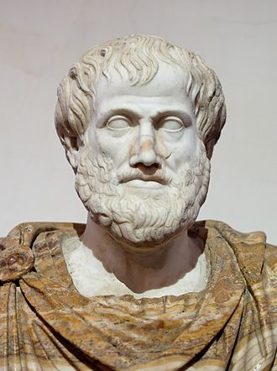
AI: intelligent systems in the real world
The world has things in it!!
first-order logic
Stuart Russell: “Unifying Logic and AI”

Slide 4

AI: intelligent systems in the real world
The world has things in it!!
The world is uncertain!!
first-order logic
probabilistic models
Stuart Russell: “Unifying Logic and AI”

Slide 5
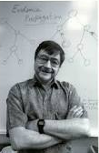
Modern AI
Probabilistic Graphical Models
propositional logic
=
+
probability

Slide 6

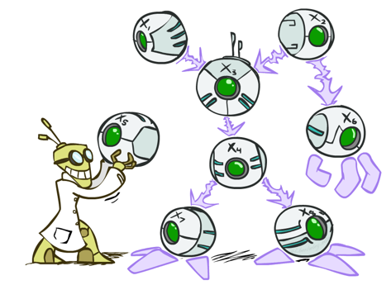
Representing Probabilistic Dependency
Two problems with using full joint distribution tables as probabilistic models:
Unless there are only a few variables, the joint is WAY too big to represent explicitly
Hard to learn (estimate) anything empirically about more than a few variables at a time
Bayesian networks: a technique for describing complex joint distributions (models) using simple, local distributions (conditional probabilities)
More properly called graphical models
Describe how variables locally interact; Local interactions chain together to give global, indirect interactions

Slide 7

Probabilistic Graphical Models
Models describe how (a portion of) the world works
Models are always simplifications
May not account for every variable
May not account for all interactions between variables
“All models are wrong; but some are useful.” – George E. P. Box
What do we do with probabilistic models?
We (or our agents) need to reason about unknown variables, given evidence
Example: explanation (diagnostic reasoning)
Example: prediction (causal reasoning)
Example: value of information

Slide 8
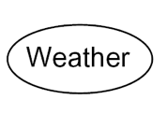
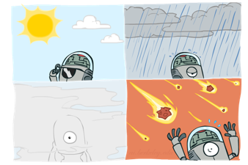

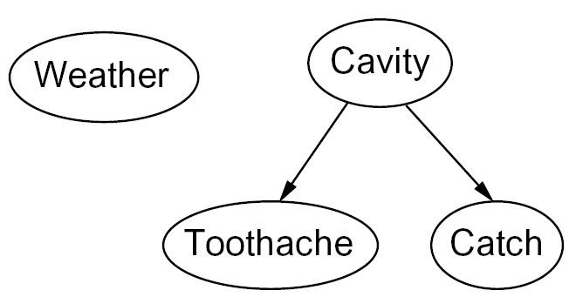
Bayesian Networks: Nodes and Arcs
Nodes: random variables (with domains)
Can be assigned (observed) or unassigned (unobserved)
Arcs: interactions
Indicate “direct influence” between variables
Formally: encode conditional independence (more later)
For now: imagine that arrows mean direct causation (in general, they don’t!)

Slide 9

Example: Coin Flips
N independent coin flips
No interactions between variables: absolute independence
X₁
X₂
X_{n}

Slide 10
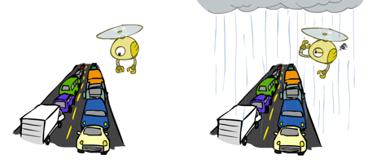
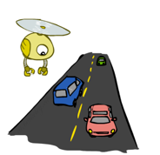
Example: Rain and Traffic
Variables:
R: It rains; T: There is traffic
Model 1: independence
Why is an agent using model 2 better?
Model 2: rain causes traffic
R
R
T
T
Notes:
GOT HERE.

Slide 11
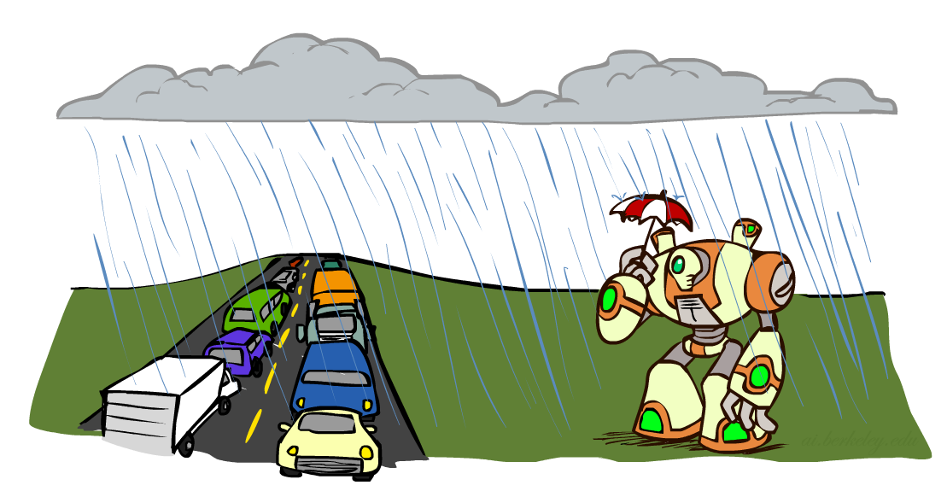
Example: Traffic II
Let’s build a graphical model
Variables
T: Traffic
R: It rains
U: Umbrella
R
T
U

Slide 12
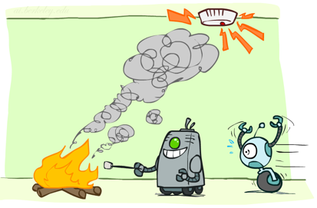
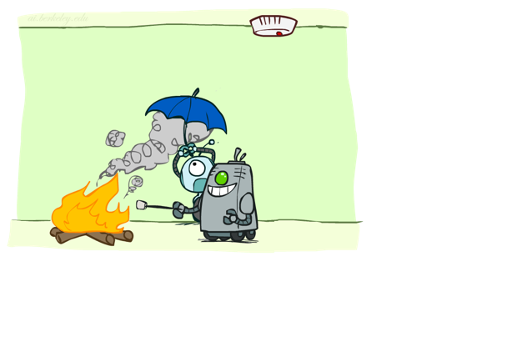
Example: fire, smoke, alarm
Variables:
Fire
Smoke
Alarm
F
S
A

Slide 13

Classic examples: image denoising

Slide 14
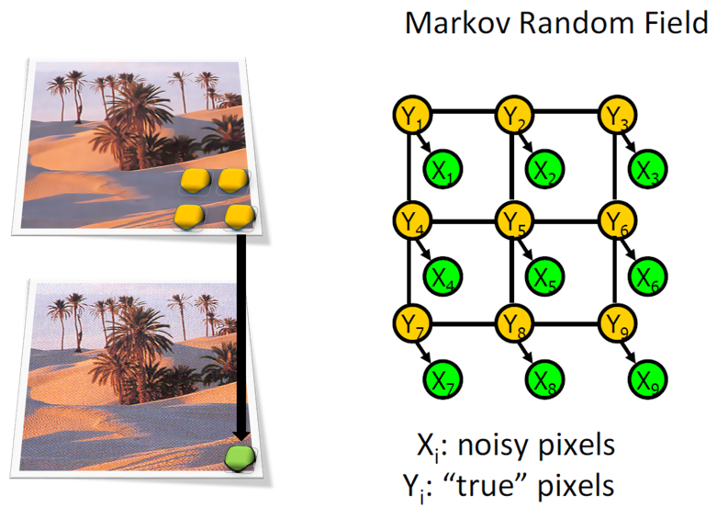
Classic examples: image denoising

Slide 15
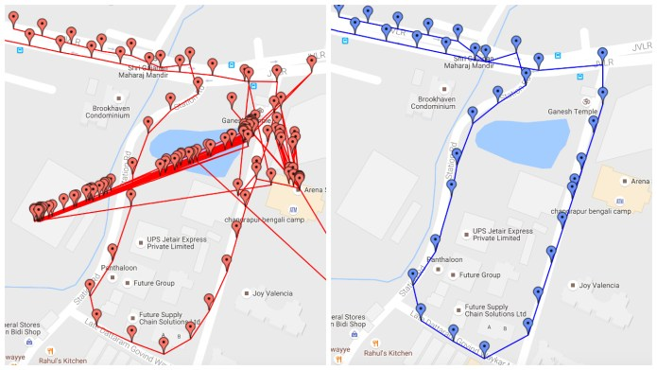
Example: localization
GPS data can be noisy

Slide 16

Example: localization
actual location,
Velocity,
acceleration
z₁
transition
z₂
z₃
z₄
emission
Observed location
x₁
x₂
x₃
x₄
Linear dynamical systems

Slide 17
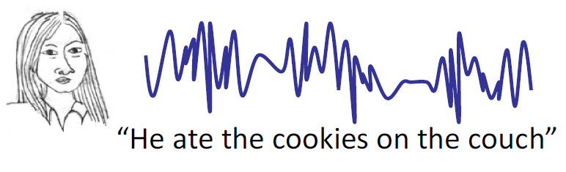
Example: automatic speech recognition (ASR)
Infer spoken words from audio signals
Hidden Markov models
Could also be modeled using RNN/Transformer
z₁
transition
z₂
z₃
z₄
words
emission
speech
x₁
x₂
x₃
x₄

Slide 18
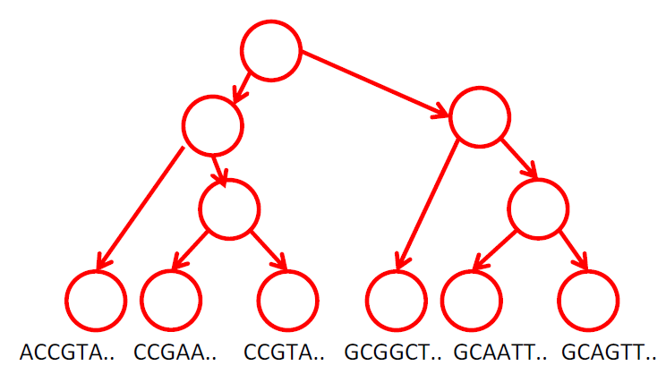
Example: evolutionary biology
Reconstruct a phylogenetic tree from DNA sequences of current species (Corvid-19)

Slide 19
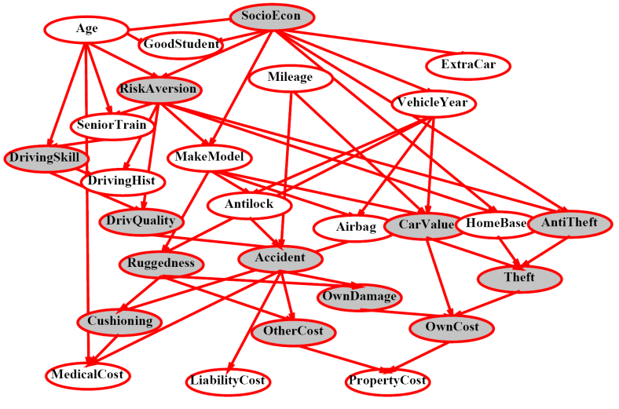
Example: Insurance

Slide 20
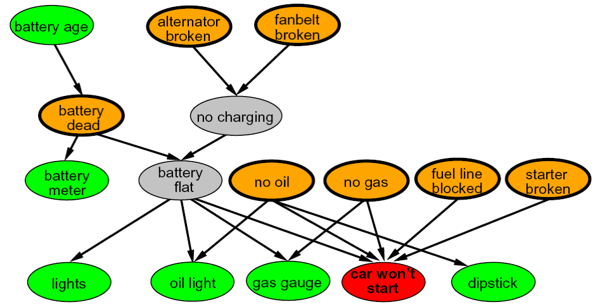
Example: Car diagnosis

Slide 21
Bayesian Networks: Nodes and Arcs
Nodes: random variables (with domains)
Can be assigned (observed) or unassigned (unobserved)
Arcs: interactions
Indicate “direct influence” between variables
Formally: encode conditional independence (more later)
For now: imagine that arrows mean direct causation (in general, they don’t!)

Slide 22

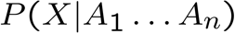
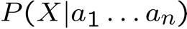
Bayesian network Semantics
A set of nodes, one per variable X
A directed, acyclic graph
A conditional distribution for each node
A collection of distributions over X, one for each combination of parents’ values
CPT: conditional probability table
Description of a noisy “causal” process
Directed graphical models
A₁
A_{n}
X
Bayesian network = Topology (graph) + Local Conditional Probabilities

Slide 23
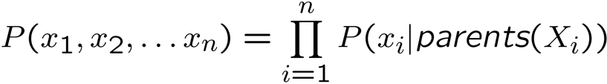

Probabilities in BNs
Bayes’ nets implicitly encode the joint distribution
As a product of local conditional distributions
To see what probability a BN gives to a full assignment, multiply all the relevant conditionals together
Example:

Slide 24
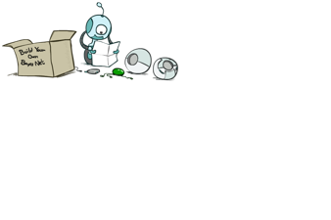

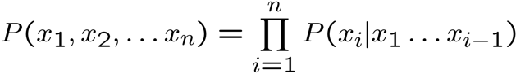

Probabilities in BNs
Why are we guaranteed that the following results in a proper joint distribution?
Chain rule (valid for all distributions):
Assume conditional independences, from topological order: → Consequence:
Not every BN can represent every joint distribution
The topology enforces certain conditional independencies

Slide 25

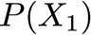
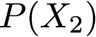
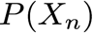
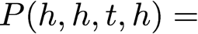
Example: Coin Flips
X₁
X₂
X_{n}
h | 0.5
t | 0.5
h | 0.5
t | 0.5
h | 0.5
t | 0.5
Only distributions whose variables are absolutely independent can be represented by a Bayesian network with no arcs.

Slide 26
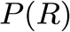
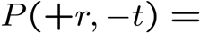
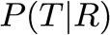
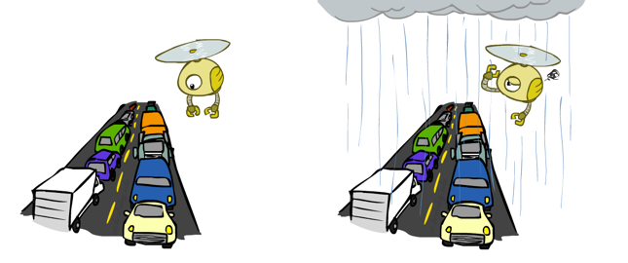

Example: Traffic
R
+r | 1/4
-r | 3/4
T
+r | +t | 3/4
 | -t | 1/4
-r | +t | 1/2
 | -t | 1/2

Slide 27
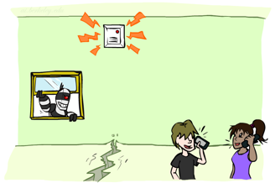
Example: Alarm Network
E | P(E)
+e | 0.002
-e | 0.998
B | P(B)
+b | 0.001
-b | 0.999
Burglary
Earthqk
B | E | A | P(A|B,E)
+b | +e | +a | 0.95
+b | +e | -a | 0.05
+b | -e | +a | 0.94
+b | -e | -a | 0.06
-b | +e | +a | 0.29
-b | +e | -a | 0.71
-b | -e | +a | 0.001
-b | -e | -a | 0.999
Alarm
John calls
Mary calls
A | J | P(J|A)
+a | +j | 0.9
+a | -j | 0.1
-a | +j | 0.05
-a | -j | 0.95
A | M | P(M|A)
+a | +m | 0.7
+a | -m | 0.3
-a | +m | 0.01
-a | -m | 0.99

Slide 28
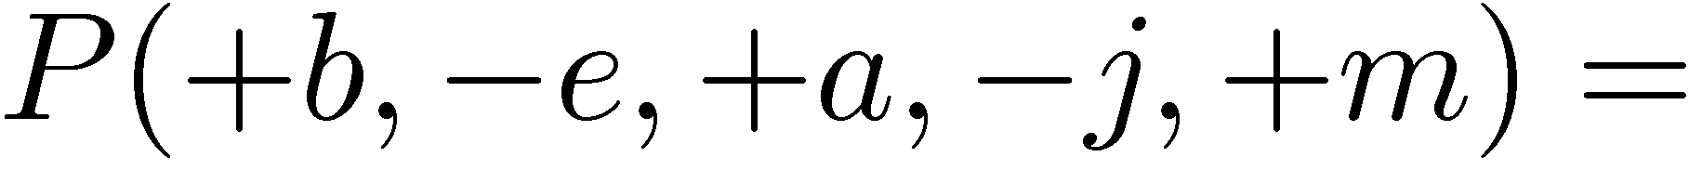
E | P(E)
+e | 0.002
-e | 0.998
B | P(B)
+b | 0.001
-b | 0.999
E | P(E)
+e | 0.002
-e | 0.998
B | P(B)
+b | 0.001
-b | 0.999
Burglary
Earthqk
B | E | A | P(A|B,E)
+b | +e | +a | 0.95
+b | +e | -a | 0.05
+b | -e | +a | 0.94
+b | -e | -a | 0.06
-b | +e | +a | 0.29
-b | +e | -a | 0.71
-b | -e | +a | 0.001
-b | -e | -a | 0.999
Alarm
B | E | A | P(A|B,E)
+b | +e | +a | 0.95
+b | +e | -a | 0.05
+b | -e | +a | 0.94
+b | -e | -a | 0.06
-b | +e | +a | 0.29
-b | +e | -a | 0.71
-b | -e | +a | 0.001
-b | -e | -a | 0.999
A | M | P(M|A)
+a | +m | 0.7
+a | -m | 0.3
-a | +m | 0.01
-a | -m | 0.99
A | J | P(J|A)
+a | +j | 0.9
+a | -j | 0.1
-a | +j | 0.05
-a | -j | 0.95
A | M | P(M|A)
+a | +m | 0.7
+a | -m | 0.3
-a | +m | 0.01
-a | -m | 0.99
A | J | P(J|A)
+a | +j | 0.9
+a | -j | 0.1
-a | +j | 0.05
-a | -j | 0.95
John calls
Mary calls

Slide 29


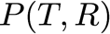
Example: Traffic
Causal direction
+r | 1/4
-r | 3/4
R
+r | +t | 3/16
+r | -t | 1/16
-r | +t | 6/16
-r | -t | 6/16
+r | +t | 3/4
 | -t | 1/4
T
-r | +t | 1/2
 | -t | 1/2

Slide 30
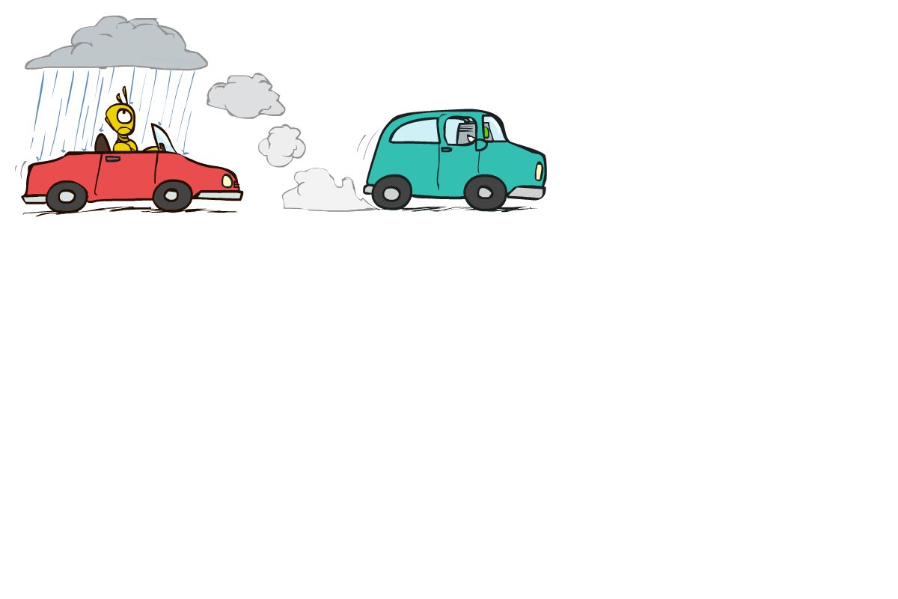
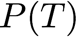
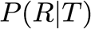
Example: Reverse Traffic
Reverse causality?
+t | 9/16
-t | 7/16
T
+r | +t | 3/16
+r | -t | 1/16
-r | +t | 6/16
-r | -t | 6/16
+t | +r | 1/3
 | -r | 2/3
R
-t | +r | 1/7
 | -r | 6/7

Slide 31
Causality?
When Bayesian networks reflect the true causal patterns:
Often simpler (nodes have fewer parents)
Often easier to think about
Often easier to elicit from experts
BNs need not actually be causal
Sometimes no causal net exists over the domain (especially if variables are missing), e.g. consider the variables Traffic and AirlineDelay
End up with arrows that reflect correlation, not causation
What do the arrows really mean?
Topology may happen to encode causal structure; Topology really encodes conditional independence

Slide 32
Bayesian Networks
So far: how a Bayesian network encodes a joint distribution
Inference: How to answer numerical queries regarding marginal distribution of a variable given observations
Learning: How to estimate parameters from data
Structure learning: how to learn graphs

Slide 33
Inference by Enumeration
Obvious problems:
Worst-case time complexity O(dn)
Space complexity O(dn) to store the joint distribution
Sample complexity (need many examples to estimate probabilities for full joint)
Need new way of specifying the joint distribution!

Slide 34
Bayes Nets: Assumptions
Definition of Bayes net given the graph,:
This assumes that a node is conditionally independent of other ancestors given its parents
Often additional conditional independences, which can be read off the graph
Important for modeling: understand assumptions made when choosing a Bayes net graphical structure

Slide 35
Example
Consider this chain shaped Bayesian Network:
What conditional independence structures do we have?
X
Y
Z
W

Slide 36
Independence in a BN
Important question about a BN:
Are two nodes independent given certain evidence?
If yes, can prove using algebra (tedious in general). If no, can prove with a counter example
Example:
Question: are X and Z necessarily independent?
Answer: no. Example: low pressure causes rain, which causes traffic.
X can influence Z, Z can influence X (via Y)
X
Y
Z

Slide 37
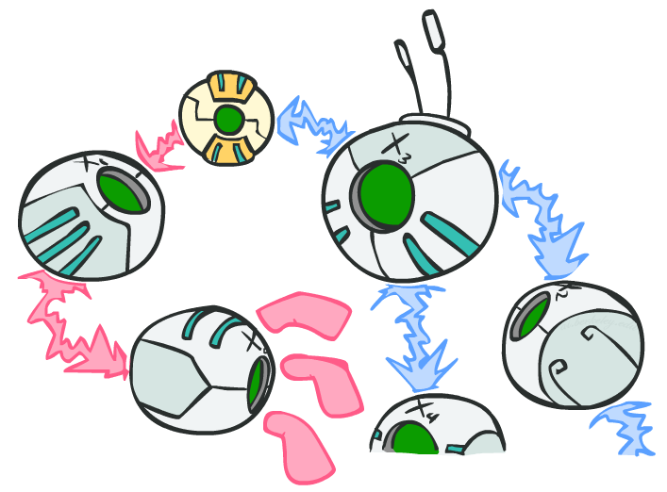
Determining conditional independence via D-separation
D-separation: a condition / algorithm for answering queries about independence
X
Y
Z

Slide 38
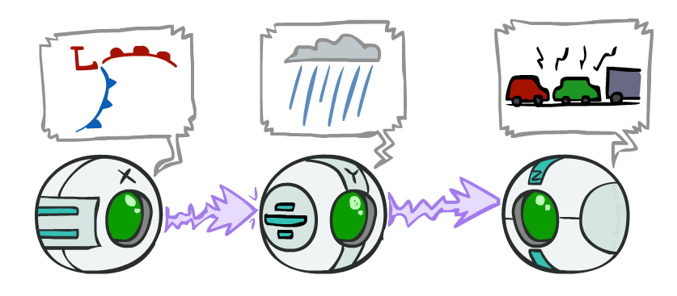
Causal Chains
This configuration is a “causal chain”
Guaranteed X independent of Z ? No
One example set of CPTs for which X is not independent of Z is sufficient to show this independence is not guaranteed
Example:
Low pressure causes rain causes traffic, high pressure causes no rain causes no traffic
In numbers: P( +y | +x ) = 1, P( -y | - x ) = 1, P( +z | +y ) = 1, P( -z | -y ) = 1
X: Low pressure Y: Rain Z: Traffic

Slide 39
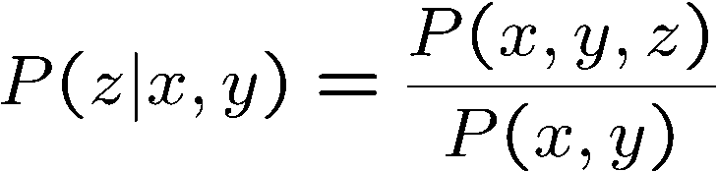
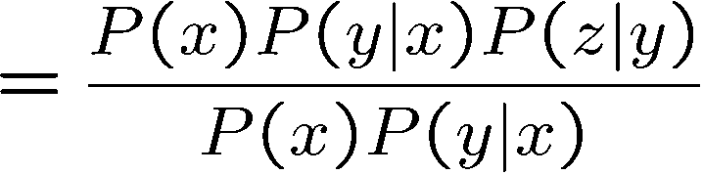
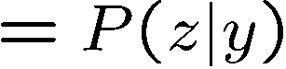
Causal Chains
This configuration is a “causal chain”
Guaranteed X independent of Z given Y?
Evidence along the chain “blocks” the influence
Yes!
X: Low pressure Y: Rain Z: Traffic

Slide 40
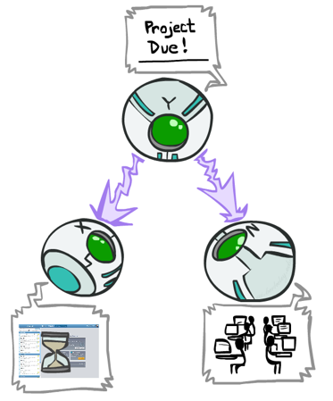
Common Cause
This configuration is a “common cause”
Guaranteed X independent of Z? No
One example set of CPTs for which X is not independent of Z is sufficient to show this independence is not guaranteed
Example:
Project due causes both forums busy and lab full
In numbers: P( +x | +y ) = 1, P( -x | -y ) = 1, P( +z | +y ) = 1, P( -z | -y ) = 1
Y: Project due
X: Forums busy
Z: Lab full

Slide 41
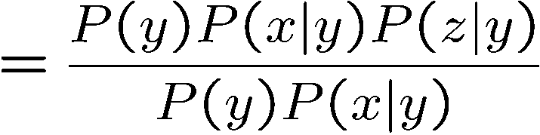
Common Cause
This configuration is a “common cause”
Guaranteed X and Z independent given Y?
Observing the cause blocks influence between effects
Y: Project due
Yes!
X: Forums busy
Z: Lab full

Slide 42
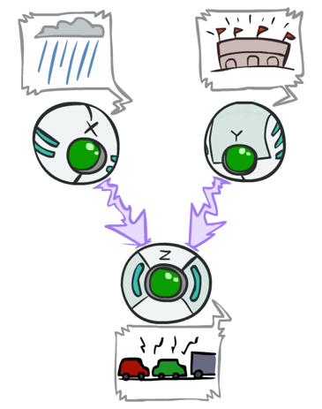
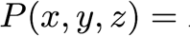
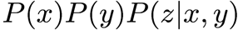
Common Effect
Last configuration: two causes of one effect (v-structure)
Are X and Y independent?
Yes: the ballgame and the rain cause traffic, but they are not correlated (Still need to prove this from Bayes net)
Are X and Y independent given Z?
No: seeing traffic puts the rain and the ballgame in competition as explanation
This is backwards from the other cases—Observing an effect activates influence between possible causes.
X: Raining
Y: Ballgame
Z: Traffic

Slide 43
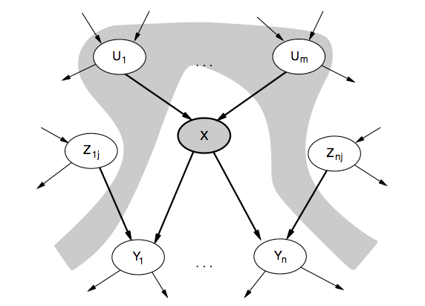
Conditional independence
Each node is conditionally independent of its non-descendents given its parents
Notes:
Each node is conditionally independent of its non-descendents given its parents

Slide 44
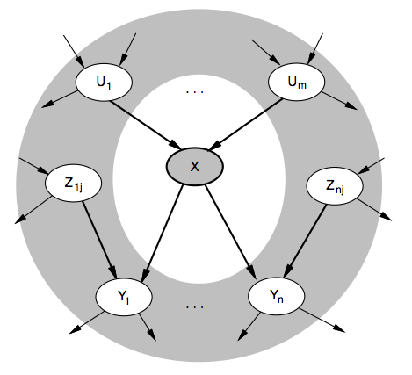
Markov Blanket
Each node is conditionally independent of the rest of the graph given its Markov Blanket
*The Markov blanket of a node A in a Bayesian network is the set of nodes composed of A's parents, A's children, and A's children's other parents.
Notes:
Each node is conditionally independent of the rest of the graph given its Markov Blanket

Slide 45
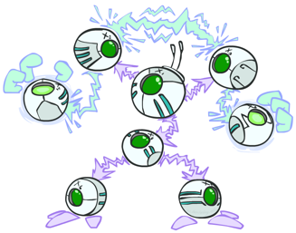
The General Case
General question: in a given BN, are two variables independent (given evidence)?
Solution: analyze the graph
Any complex example can be broken into repetitions of the three canonical cases

Slide 46

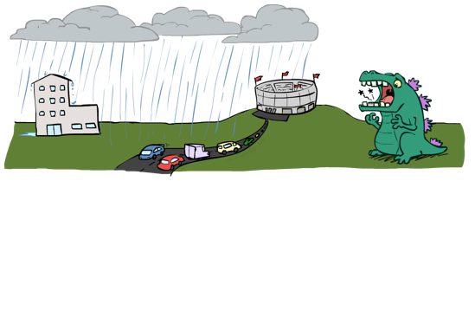
Reachability
Recipe: shade evidence nodes, look for paths in the resulting graph
Attempt 1: if two nodes are connected by an undirected path not blocked by a shaded node, they are conditionally independent
Almost works, but not quite
Where does it break?
Answer: the v-structure at T doesn’t count as a link in a path unless “active”
L
R
B
D
T

Slide 47
Active / Inactive Paths
Question: Are X and Y conditionally independent given evidence variables {Z}?
Yes, if X and Y “d-separated” by Z
Consider all (undirected) paths from X to Y
No active paths = independence!
A path is active if each triple is active:
Causal chain A → B → C where B is unobserved (either direction)
Common cause A ← B → C where B is unobserved
Common effect (aka v-structure) A → B ← C where B or one of its descendents is observed
All it takes to block a path is a single inactive segment
Active Triples
Inactive Triples

Slide 48





D-Separation
Query:
Check all (undirected!) paths between and
If one or more active, then independence not guaranteed
Otherwise (i.e. if all paths are inactive),then independence is guaranteed
?

Slide 49



Example
Yes
R
B
T
T’

Slide 50





Example
L
Yes
R
B
Yes
D
T
Yes
T’

Slide 51



Example
Variables:
R: Raining; T: Traffic
D: Roof drips; S: I’m sad
Questions:
R
T
D
S
Yes

Slide 52


Structure Implications
Given a Bayes net structure, can run d-separation algorithm to build a complete list of conditional independences that are necessarily true of the form
This list determines the set of probability distributions that can be represented

Slide 53

Computing All Independences
Y
X
Z
Y
X
Z
X
Z
Y
Y
X
Z

Slide 54

Graph Topology Limits Distributions
Given some graph topology G, only certain joint distributions can be encoded
The graph structure guarantees certain (conditional) independences (there might be more independence)
Y
X
Z
Y
X
Z
Y
X
Z
Y
X
Z
Y
Y
Y
X
Z
X
Z
X
Z
Y
Y
Y
X
Z
X
Z
X
Z

Slide 55
Bayes Networks: Summary
Bayes nets compactly encode joint distributions
Guaranteed independencies of distributions can be deduced from BN graph structure
D-separation gives precise conditional independence guarantees from graph alone
A Bayesian network’s joint distribution may have further (conditional) independence that is not detectable until you inspect its specific (quantitative) distribution

Slide 56

Inference
Inference: calculating some useful quantity from a joint probability distribution
Examples:
Posterior probability
Most likely explanation:

Slide 57










Inference by Enumeration
General case:
Evidence variables:
Query* variable:
Hidden variables:
Step 1: Select the entries consistent with the evidence
Step 2: Sum out H to get joint of query and evidence
Step 3: Normalize

Slide 58




Inference by Enumeration in Bayes Net
Given unlimited time, inference in BNs is easy
Reminder of inference by enumeration by example:
B
E
A
J
M

Slide 59

Inference by Enumeration?

Slide 60


Variable Elimination
Why is inference by enumeration so slow?
You join up the whole joint distribution before you sum out the hidden variables
Idea: interleave joining and marginalizing
Called “Variable Elimination”
Still NP-hard, but usually much faster than inference by enumeration
First we’ll need some new notation: factors

Slide 61


Factor Zoo I
Joint distribution: P(X,Y)
Entries P(x,y) for all x, y
Sums to 1
Selected joint: P(x,Y)
A slice of the joint distribution
Entries P(x,y) for fixed x, all y
Sums to P(x)
Number of capital letters = dimensionality of the table
T | W | P
hot | sun | 0.4
hot | rain | 0.1
cold | sun | 0.2
cold | rain | 0.3
T | W | P
cold | sun | 0.2
cold | rain | 0.3

Slide 62




Factor Zoo II
Single conditional: P(Y | x)
Entries P(y | x) for fixed x, all y
Sums to 1
Family of conditionals: P(X |Y)
Multiple conditionals
Entries P(x | y) for all x, y
Sums to |Y|
T | W | P
cold | sun | 0.4
cold | rain | 0.6
T | W | P
hot | sun | 0.8
hot | rain | 0.2
cold | sun | 0.4
cold | rain | 0.6

Slide 63




Factor Zoo III
Specified family: P( y | X )
Entries P(y | x) for fixed y, but for all x
Sums to … unknown
T | W | P
hot | rain | 0.2
cold | rain | 0.6

Slide 64
Factor Zoo Summary
In general, when we write P(Y1 … YN | X1 … XM)
It is a “factor,” a multi-dimensional array
Its values are P(y1 … yN | x1 … xM)
Any assigned (=lower-case) X or Y is a dimension missing (selected) from the array

Slide 65






Example: Traffic Domain
Random Variables
R: Raining
T: Traffic
L: Late for class
R
+r | 0.1
-r | 0.9
T
+r | +t | 0.8
+r | -t | 0.2
-r | +t | 0.1
-r | -t | 0.9
L
+t | +l | 0.3
+t | -l | 0.7
-t | +l | 0.1
-t | -l | 0.9

Slide 66






Inference by Enumeration: Procedural Outline
Track objects called factors
Initial factors are local CPTs (one per node)
Any known values are selected, e.g. if we know , the initial factors are:
Procedure: Join all factors, then eliminate all hidden variables
+r | +t | 0.8
+r | -t | 0.2
-r | +t | 0.1
-r | -t | 0.9
+t | +l | 0.3
+t | -l | 0.7
-t | +l | 0.1
-t | -l | 0.9
+r | 0.1
-r | 0.9
+r | +t | 0.8
+r | -t | 0.2
-r | +t | 0.1
-r | -t | 0.9
+t | +l | 0.3
-t | +l | 0.1
+r | 0.1
-r | 0.9

Slide 67





Operation 1: Join Factors
First basic operation: joining factors
Combining factors: (just like a database join)
Get all factors over the joining variable; Build a new factor over the union of the variables involved
Example: Join on R
Computation for each entry: pointwise products
R
+r | 0.1
-r | 0.9
+r | +t | 0.8
+r | -t | 0.2
-r | +t | 0.1
-r | -t | 0.9
+r | +t | 0.08
+r | -t | 0.02
-r | +t | 0.09
-r | -t | 0.81
R,T
T

Slide 68

Example: Multiple Joins

Slide 69



Example: Multiple Joins
+r | 0.1
-r | 0.9
R
Join R
+r | +t | 0.08
+r | -t | 0.02
-r | +t | 0.09
-r | -t | 0.81
Join T
R, T, L
T
R, T
+r | +t | 0.8
+r | -t | 0.2
-r | +t | 0.1
-r | -t | 0.9
L
+r | +t | +l | 0.024
+r | +t | -l | 0.056
+r | -t | +l | 0.002
+r | -t | -l | 0.018
-r | +t | +l | 0.027
-r | +t | -l | 0.063
-r | -t | +l | 0.081
-r | -t | -l | 0.729
L
+t | +l | 0.3
+t | -l | 0.7
-t | +l | 0.1
-t | -l | 0.9
+t | +l | 0.3
+t | -l | 0.7
-t | +l | 0.1
-t | -l | 0.9

Slide 70


Operation 2: Eliminate
Second basic operation: marginalization
Take a factor and sum out a variable
Shrinks a factor to a smaller one
A projection operation
Example:
+r | +t | 0.08
+r | -t | 0.02
-r | +t | 0.09
-r | -t | 0.81
+t | 0.17
-t | 0.83

Slide 71



Multiple Elimination
R, T, L
T, L
L
+r | +t | +l | 0.024
+r | +t | -l | 0.056
+r | -t | +l | 0.002
+r | -t | -l | 0.018
-r | +t | +l | 0.027
-r | +t | -l | 0.063
-r | -t | +l | 0.081
-r | -t | -l | 0.729
Sum
out R
Sum
out T
+t | +l | 0.051
+t | -l | 0.119
-t | +l | 0.083
-t | -l | 0.747
+l | 0.134
-l | 0.886

Slide 72

Variable Elimination = Marginalizing Early

Slide 73


Traffic Domain
Inference by Enumeration
R
Variable Elimination
T
Join on r
Join on r
L
Join on t
Eliminate r
Eliminate r
Join on t
Eliminate t
Eliminate t

Slide 74


Variable Elimination
Join R
Sum out R
Sum out T
Join T
+r | +t | 0.08
+r | -t | 0.02
-r | +t | 0.09
-r | -t | 0.81
+r | 0.1
-r | 0.9
+t | 0.17
-t | 0.83
R
R, T
T
T, L
L
+r | +t | 0.8
+r | -t | 0.2
-r | +t | 0.1
-r | -t | 0.9
T
L
L
+t | +l | 0.051
+t | -l | 0.119
-t | +l | 0.083
-t | -l | 0.747
+l | 0.134
-l | 0.866
L
+t | +l | 0.3
+t | -l | 0.7
-t | +l | 0.1
-t | -l | 0.9
+t | +l | 0.3
+t | -l | 0.7
-t | +l | 0.1
-t | -l | 0.9
+t | +l | 0.3
+t | -l | 0.7
-t | +l | 0.1
-t | -l | 0.9

Slide 75



Evidence
If evidence, start with factors that select that evidence
No evidence uses these initial factors:
To compute , the initial factors become:
Then we eliminate all variables other than query + evidence
+r | 0.1
-r | 0.9
+r | +t | 0.8
+r | -t | 0.2
-r | +t | 0.1
-r | -t | 0.9
+t | +l | 0.3
+t | -l | 0.7
-t | +l | 0.1
-t | -l | 0.9
+r | 0.1
+r | +t | 0.8
+r | -t | 0.2
+t | +l | 0.3
+t | -l | 0.7
-t | +l | 0.1
-t | -l | 0.9

Slide 76


Evidence
Result will be a selected joint of query and evidence
To get our answer, just normalize — that ’s it!
E.g. for P(L | +r), we would end up with:
Normalize
+r | +l | 0.026
+r | -l | 0.074
+l | 0.26
-l | 0.74

Slide 77




General Variable Elimination
Query:
Start with initial factors:
Local CPTs (but instantiated by evidence)
While there are still hidden variables (not Q or evidence):
Pick a hidden variable H
Join all factors mentioning H
Eliminate (sum out) H
Join all remaining factors and normalize

Slide 78









Example
Choose A

Slide 79




Example
Choose E
Finish with B
Normalize

Slide 80

Same Example in Equations
marginal can be obtained from joint by summing out
use Bayes’ net joint distribution expression
use x*(y+z) = xy + xz
joining on a, and then summing out gives f1
use x*(y+z) = xy + xz
joining on e, and then summing out gives f2
All we are doing is exploiting uwy + uwz + uxy + uxz + vwy + vwz + vxy +vxz = (u+v)(w+x)(y+z) to improve computational efficiency!

Slide 81
Summary
Bayesian networks:
Directed acyclic graph
Nodes are random variables
arcs are probabilistic dependencies
Examine dependence of two variables given observation: d-separation
Inference:
Variable elimination for discrete variables

Slide 82
Next up
Gaussian Mixture Model
Linear Dynamical Systems
Learning parameters for BNs

